Slide 1
NLP and Pre-Processing for NLP

Slide 2
Welcome
How is everyone doing?
Main goal for today: improve pre-processing for NLP and model text data
When will you need this information?
When training NLP models
When solving Individual DE assignments

Slide 3
Workshop overview
NLP’s role in analyzing and interpreting large volumes of social text data.
Emphasis on the importance of pre-processing in NLP tasks

Slide 4
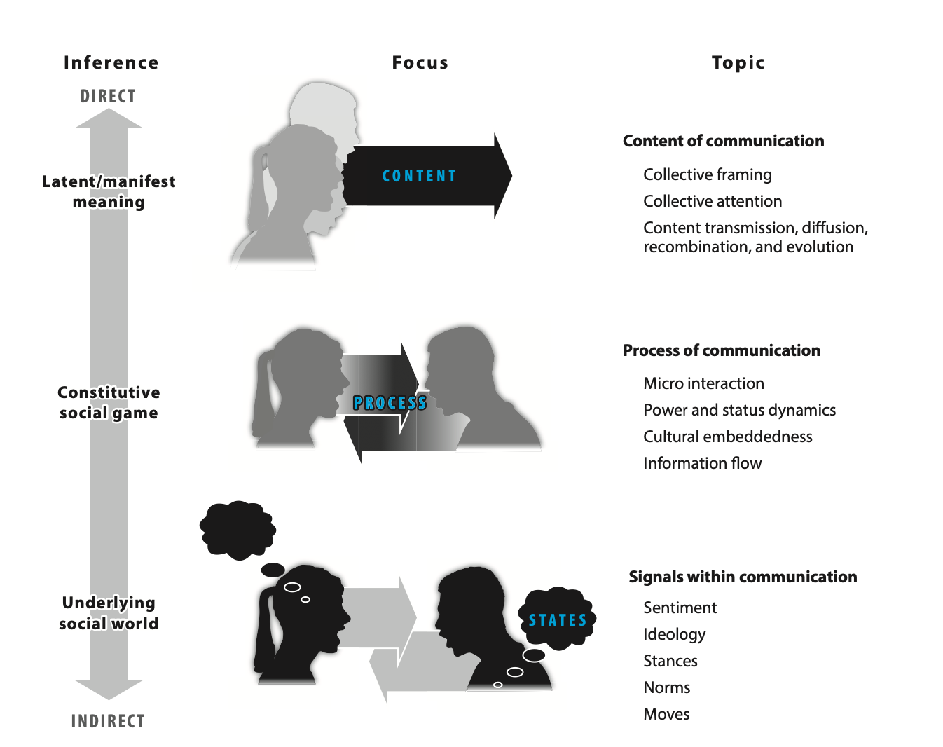
Mining text in the social sciences: inferences from text
Evans & Aceves (2016)
Notes:
Social inferences from communication. Computational text analysis articles can be categorized according to the depth of inferences they make about the social world, with foci ranging from (a) collective attention, framing, and thinking through the manifest and latent content of communication; to (b) social relationships through analysis of the process of communication; and ultimately (c) social identities, states, roles, and moves through linguistic signals embedded in communication.

Slide 5
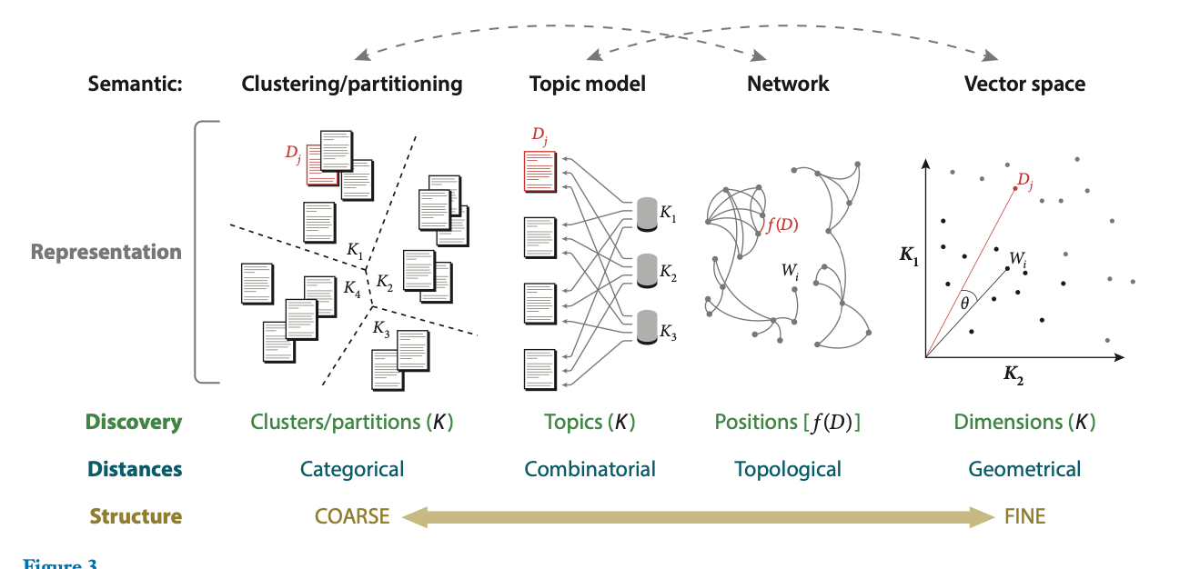
NLP Tasks Overview
Evans and Aceves (2016)
Notes:
From Evans (2016): “Properties of four common semantic representations. Four of the most widely used semantic representations of text, linked to the most frequently deployed unsupervised machine learning approaches, are clustering, topic modeling, semantic network induction, and vector space word embedding. In these representations, D represents documents, W represents words within those documents, and K represents discovered semantic structures. Document clusters, in which similar texts are typically grouped by shared words, closely relate to semantic networks, in which similar words often link as a function of the documents in which they co-occur, f(D). Topic models, which represent documents as sparse mixtures of induced topics, are closely related to vector space word embeddings, which define documents, words, and phrases as dense mixtures of induced dimensions, or vectors plotted in a space anchored by those dimensions.
”

Slide 6
Importance of Pre-processing
Pre-processing shapes data for effective NLP analysis.
Pre-processing choices have an impact on the accuracy and reliability of NLP models.

Slide 7
Pre-processing Steps
Text Cleaning
Case Normalization
Tokenization
Stop Words Removal
Stemming
Lemmatization

Slide 8
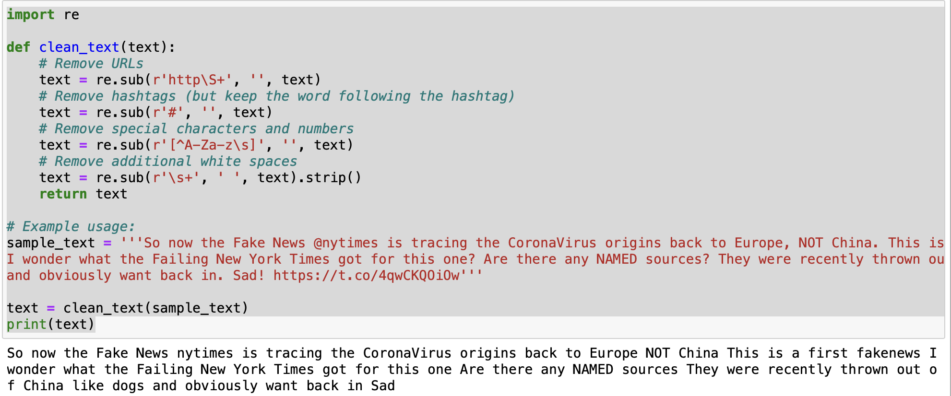
Pre-processing steps: text cleaning
Notes:
Step 1: Text Cleaning The first step is to clean the text. We remove any irrelevant items like HTML tags, URLs, and codes when dealing with web data. We also get rid of special characters, numbers, or punctuation that might not be necessary for analysis.

Slide 9
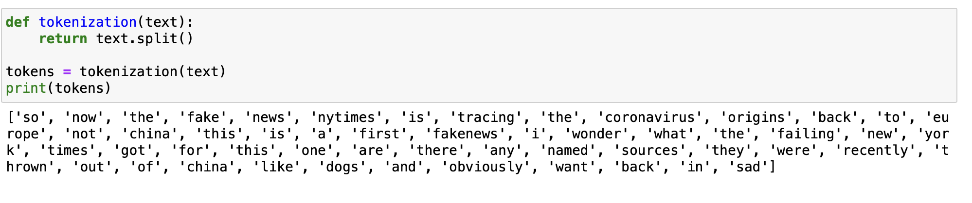
Pre-processing steps: tokenization
Notes:
Step 3: Tokenization Then we move to tokenization. This is where we break down the text into smaller pieces, or tokens. Tokens can be words, phrases, or even sentences. In English, this might seem as simple as splitting by spaces, but it can get complicated with languages that don’t use spaces or have complex morphology.

Slide 10
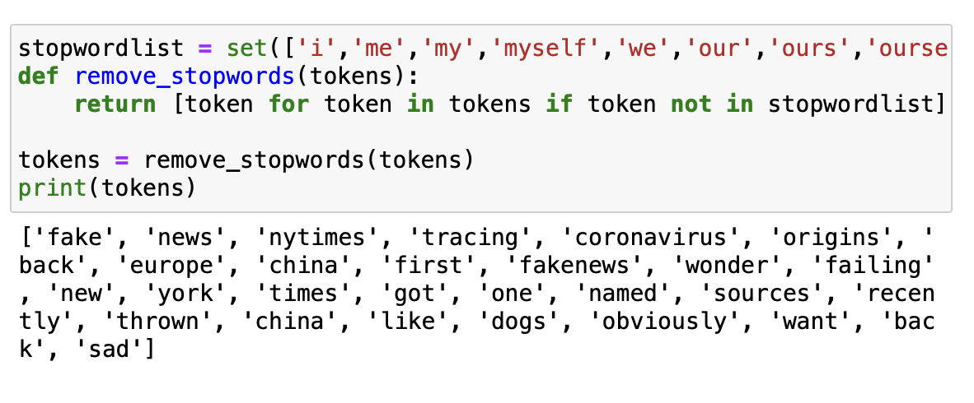
Preprocessing Steps: stopword removal
Notes:
Step 4: Stop Words Removal After tokenization, we often remove stop words. These are common words like 'is', 'and', 'the', which appear frequently in the text but usually don’t carry significant meaning for the analysis.

Slide 11
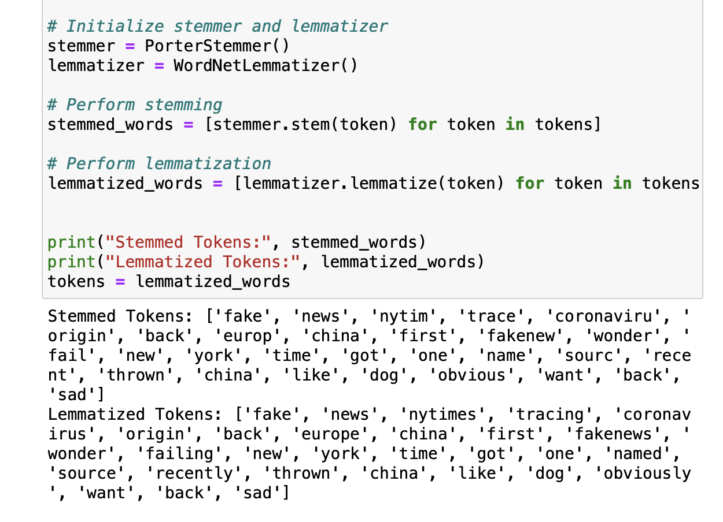
Pre-processing steps: stemming and lemmatization
Notes:
Step 5: Stemming or Lemmatization Now, we refine our tokens using stemming and lemmatization. Stemming strips the words down to their root form, often leading to a form that's not a proper word. Lemmatization is a more sophisticated approach that reduces words to their dictionary form known as the lemma. For example, 'running', 'runs', and 'ran' might all be reduced to 'run'.

Slide 12
Lecture review: representation Methods
Bag-of-Words (BoW):
Represents text as the frequency of words.
Useful for models that rely on word occurrence.
Pros: Simple, effective for certain tasks.
Cons: Ignores word order and context.

Slide 13
Lecture review: representation Methods
Bag-of-Words (BoW):
Represents text as the frequency of words.
Useful for models that rely on word occurrence.
Pros: Simple, effective for certain tasks.
Cons: Ignores word order and context.
TF-IDF (Term Frequency-Inverse Document Frequency):
Considers word frequency and uniqueness across documents.
Highlights important words in each document.
Pros: More informative than BoW.
Cons: Still ignores word context.

Slide 14
Lecture review: representation Methods
Bag-of-Words (BoW):
Represents text as the frequency of words.
Useful for models that rely on word occurrence.
Pros: Simple, effective for certain tasks.
Cons: Ignores word order and context.
TF-IDF (Term Frequency-Inverse Document Frequency):
Considers word frequency and uniqueness across documents.
Highlights important words in each document.
Pros: More informative than BoW.
Cons: Still ignores word context.
Word Embeddings:
Maps words to vectors in a continuous space based on context.
Captures semantic relationships between words.
Pros: Context-aware, captures deeper meanings.
Cons: Computationally intensive, requires large datasets.

Slide 15
Review: Applications
Sentiment Analysis Using Vader
Introduction to sentiment analysis focusing on the Vader tool.
Effective for analyzing sentiment in text data.
Example in notebook: Applying Vader to analyze sentiments in Trump’s tweets.
Visualization of sentiment trends to illustrate fluctuations over time.

Slide 16
Review: Applications
Sentiment Analysis Using Vader
Introduction to sentiment analysis focusing on the Vader tool.
Effective for analyzing emotions and opinions in text data.
Example: Applying Vader to analyze sentiments in tweets.
Visualization of sentiment trends to illustrate fluctuations over time.
Topic Modeling with BERTopic
Exploring topics within text using BERTopic.
Demonstrates automatic extraction of themes from a dataset.
Interpretation of results with visual aids, such as topic trend graphs.
Useful in identifying underlying patterns and themes in large text corpora.

Slide 17
Review: Applications
Sentiment Analysis Using Vader
Introduction to sentiment analysis focusing on the Vader tool.
Effective for analyzing emotions and opinions in text data.
Example: Applying Vader to analyze sentiments in tweets.
Visualization of sentiment trends to illustrate fluctuations over time.
Topic Modeling with BERTopic
Exploring topics within text using BERTopic.
Demonstrates automatic extraction of themes from a dataset.
Interpretation of results with visual aids, such as topic trend graphs.
Useful in identifying underlying patterns and themes in large text corpora.
Machine Learning in Text Analysis
Using machine learning (ML) for text classification tasks.
Example: Classifying tweets based on the device type (iPhone or Android).
Overview of the Random Forest Classifier and its role in feature importance analysis.

Slide 18
Work in notebook: setting up packages and data
Key python packages: pandas for data handling, nltk for stemming and lemmatization, BERTopic for topic modeling, and VADER for sentiment analysis.
Dataset: Trump's tweets

